Slide 1


TECH COMPANY
P R E S E N T A T I O N

Slide 2



TECH COMPANY
A presentation is a formal or informal communication method that involves conveying information, ideas, or a message to an audience.
RIMBERIO COMPANY

Slide 3



ABOUT US
A presentation is a formal or informal
involves
communication method that
conveying information, ideas, or a message to an audience. It often employs visual aids such as slides, charts, graphs, or multimedia elements to support and enhance the spoken content.
RIMBERIO COMPANY

Slide 4



VISION
A presentation is a formal or informal communication method that involves conveying information, ideas, or a message to an audience. It often employs visual aids such as slides, charts, graphs, or multimedia elements to support and enhance the spoken content.
RIMBERIO COMPANY

Slide 5


MISSION
A presentation is a formal or informal communication method that involves conveying information, ideas, or a message to an audience. It often employs visual aids such as slides, charts, graphs, or multimedia elements to support and enhance the spoken content.
RIMBERIO COMPANY

Slide 6





TEAM
Juliana Silva
Founder
Sascha Dubois
Designer
Olivia Wilson
Developer

Slide 7


MARKET OVERVIEW
19.5%
Market Growth Rate
$3.7 Billion
Market Size
29%
Growth for 2026
RIMBERIO COMPANY

Slide 8


ROADMAP
Q1
Idea Generation Market Research Concept
Brand Survey
Q2
Brand Awareness & Marketing Component Research
Cost Analysis
Q3
Testing functions Apps interaction Product Handling Launch

Slide 9
Product 2
We build software that empowers organizations to effectively integrate their data, decisions, and operations.
Product 1
Product 3
PRODUCT
Product 4

Slide 10

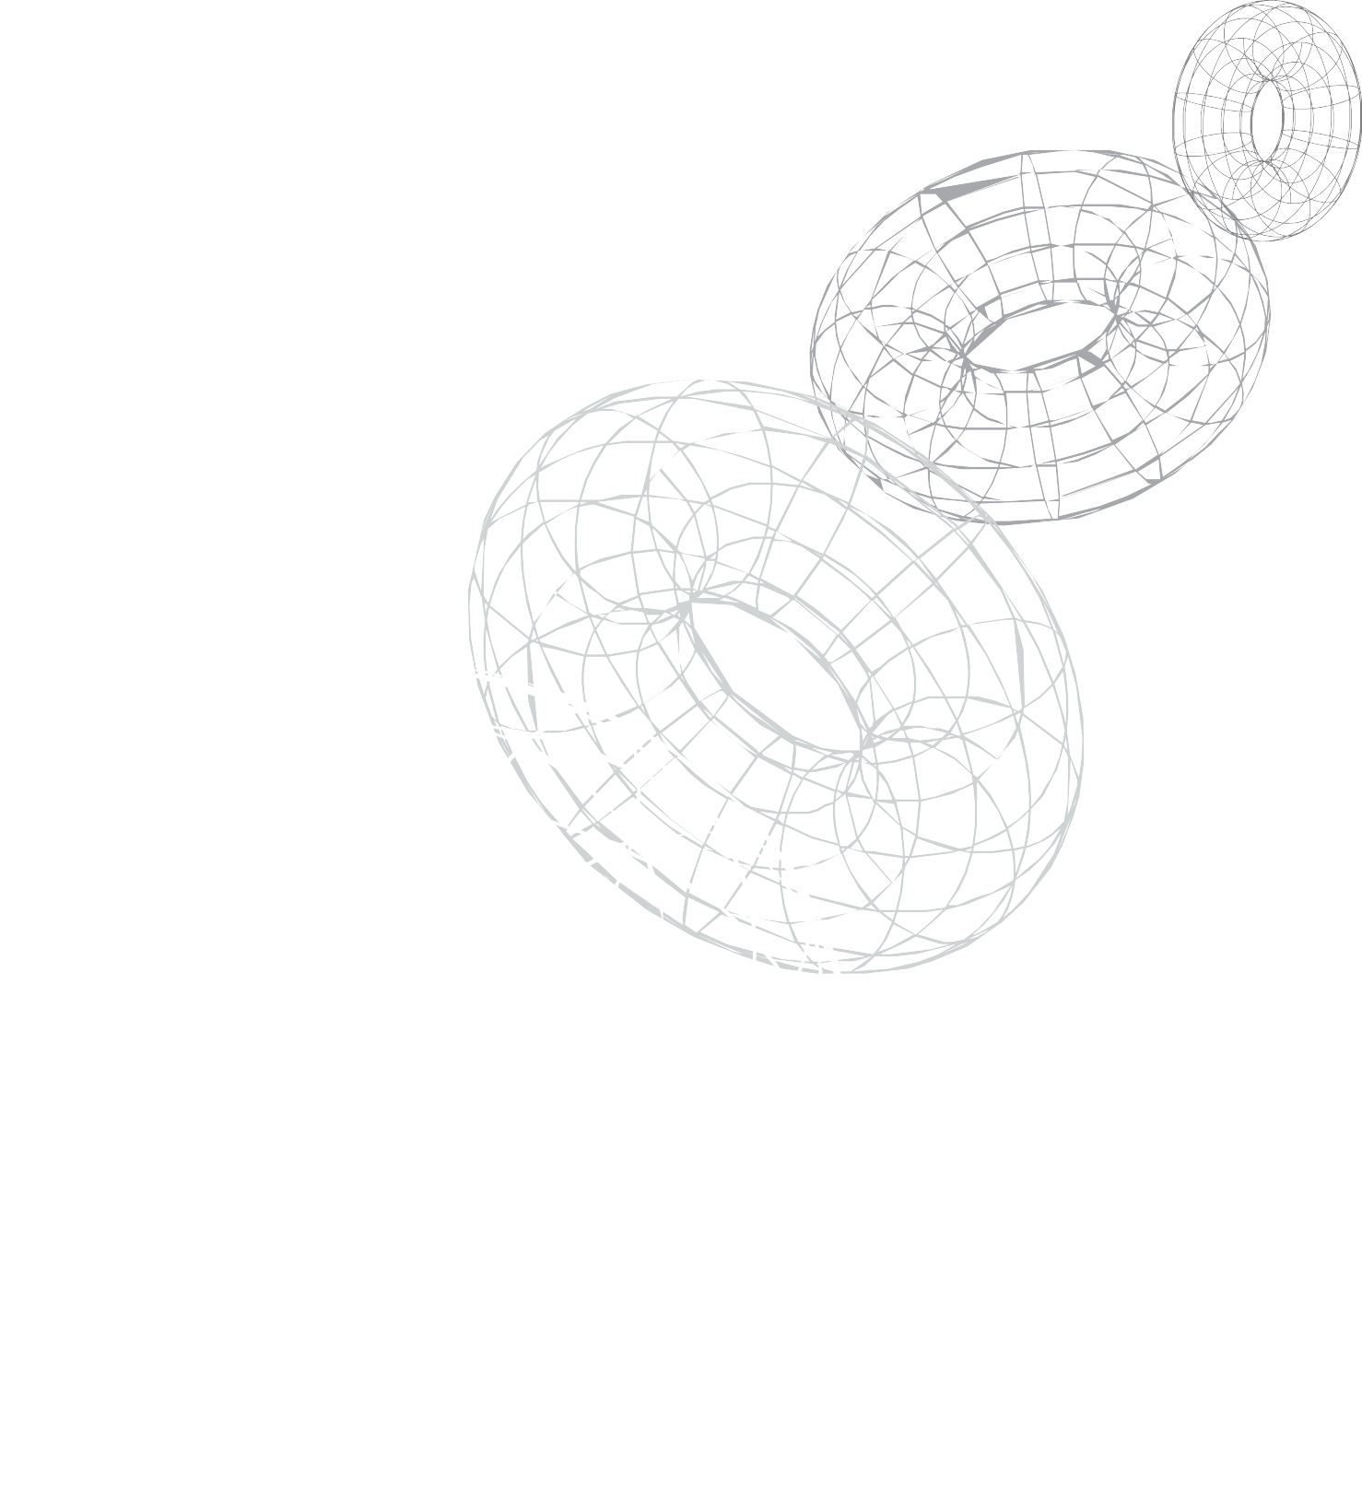

WHAT WE DO
A presentation is a formal or informal
involves
communication method that
conveying information, ideas, or a message to an audience. It often employs visual aids such as slides, charts, graphs, or multimedia elements to support and enhance the spoken content.
RIMBERIO COMPANY

Slide 11




PROJECT 1
We build software that empowers organizations to effectively integrate their data, decisions, and operations.
We build software that empowers organizations to effectively integrate their data, decisions, and operations.
We build software that empowers organizations to effectively integrate their data, decisions, and operations.

Slide 12


PROJECT 2
We build software that empowers organizations to effectively integrate their data, decisions, and operations.
We build software that empowers organizations to effectively integrate their data, decisions, and operations.
We build software that empowers organizations to effectively integrate their data, decisions, and operations.

Slide 13

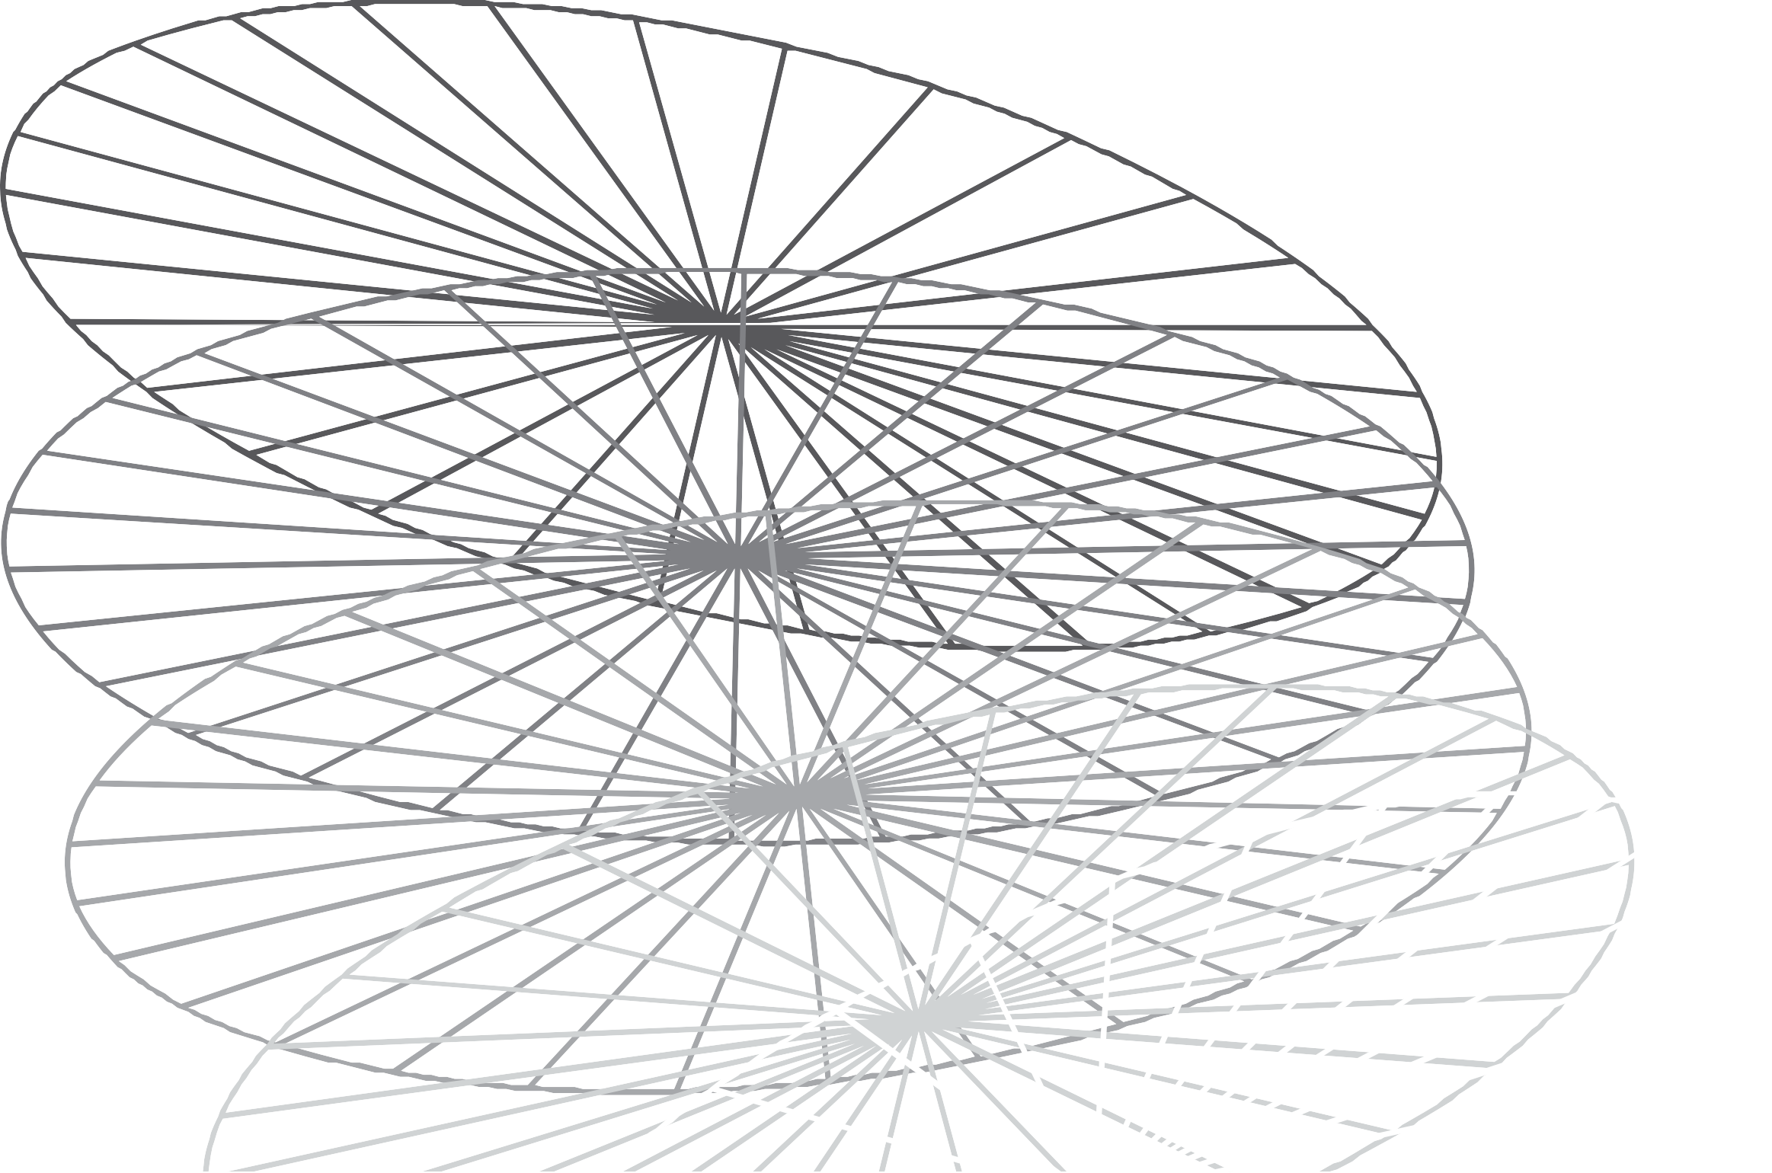

We build software that empowers organizations to effectively integrate their data, decisions, and operations.
RIMBERIO COMPANY

Slide 14


CONTACT US
@reallygreatsite
hello@reallygreatsite.com www.reallygreatsite.com
123 Anywhere ST., Any City, ST 12345

Slide 15



THANK YOU
T E C H C O M P A N Y

